Slide 1


Terraform
B
Y
K
U
M
A
R
B
Y
K
U
M
A
R

Slide 2
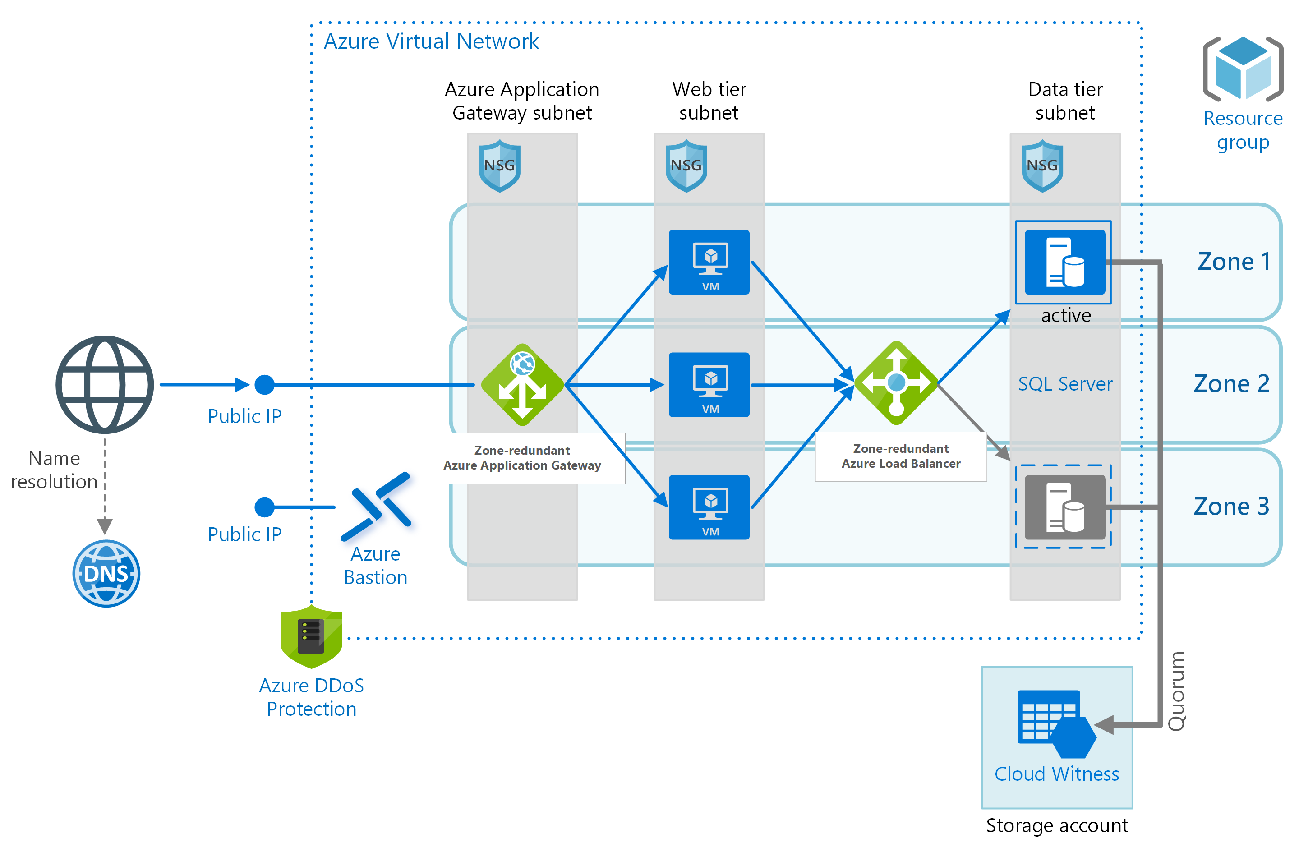


Terraform Architecture
Modules
*.tf
*.tfvars
Azure Cloud Provider
Plugins

Slide 3
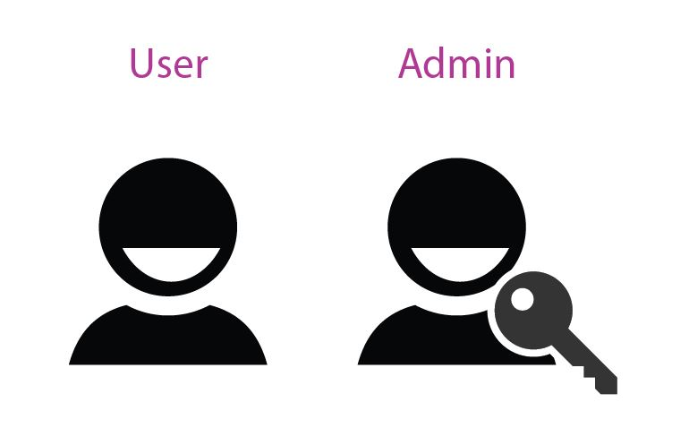
Terraform Architecture
Windows 10

